Slide 1


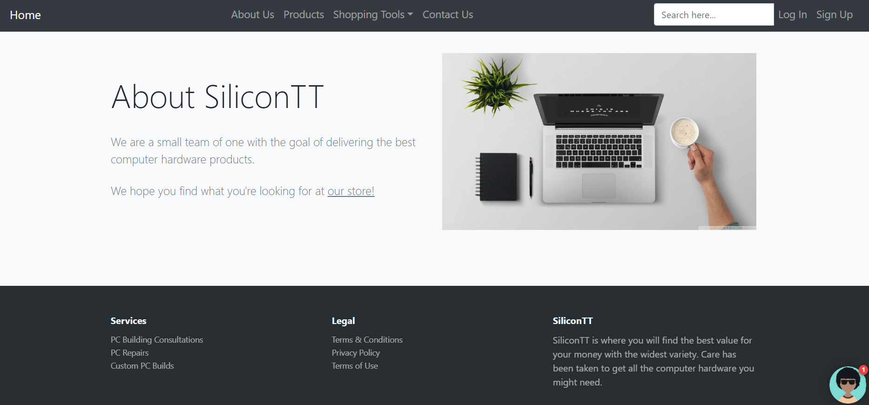
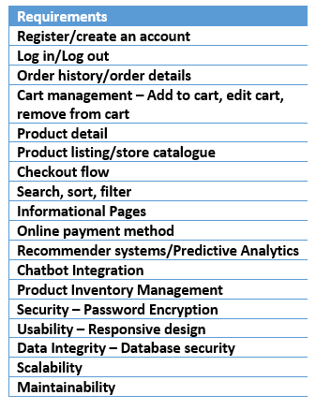
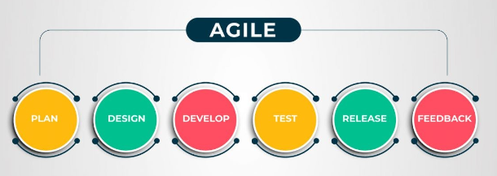
Leveraging enhanced User Experience (UX), Predictive Analytics & Artificial Intelligence (AI) to augment an E-commerce application to boost sales and customer retention
Lincia Walters
Student ID: 2136919
BSc Information Technology, Department of Computer Science & Technology
Introduction
The project’s aim is to develop a computer hardware e-commerce application that utilizes sound UX design, predictive analytics and AI to enhance the customer experience, increase sales and encourage repeat buying.
Results
Requirements
Methodology
Limited time and a team of one made AGILE the most appropriate.
Problem
Local sites poorly designed
Lack of variety to help customers make better buying decisions
Limits on foreign exchange prevents international shopping
Lack of AI technology to assist customers
How will I solve the problem?
Site designed with good UX in mind
Site will have enough variety
Chatbot implemented
Incorporate predictive analytics
Conclusion
13 out of 14 requirements completed.
Site solves all problems identified.
Testing and evaluation completed.
Artefact ready to launch.

